Slide 1
Conversational Design
Tanya Dellicompagni

Slide 2


What is Conversational Design?
The role of a conversation designer considers both the user’s needs and the technological constraints. They partner with stakeholders and developers to iterate on the designs and bring the experience to life.

Slide 3
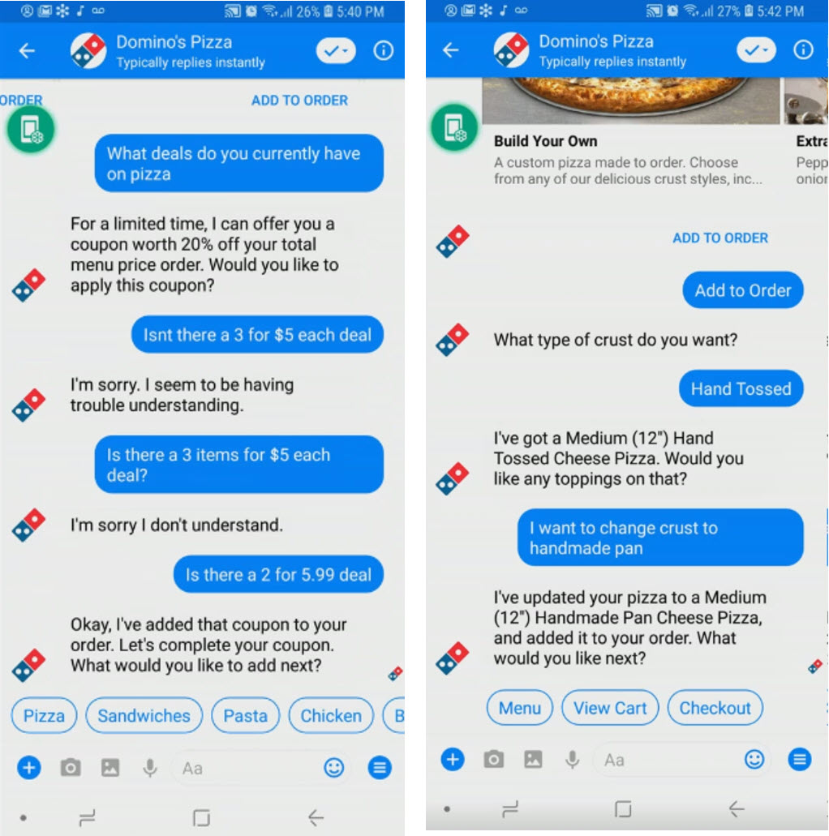
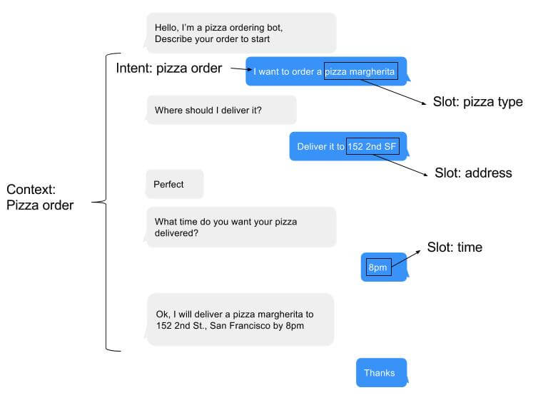
Sample Dialogue: Pizza order

Slide 4
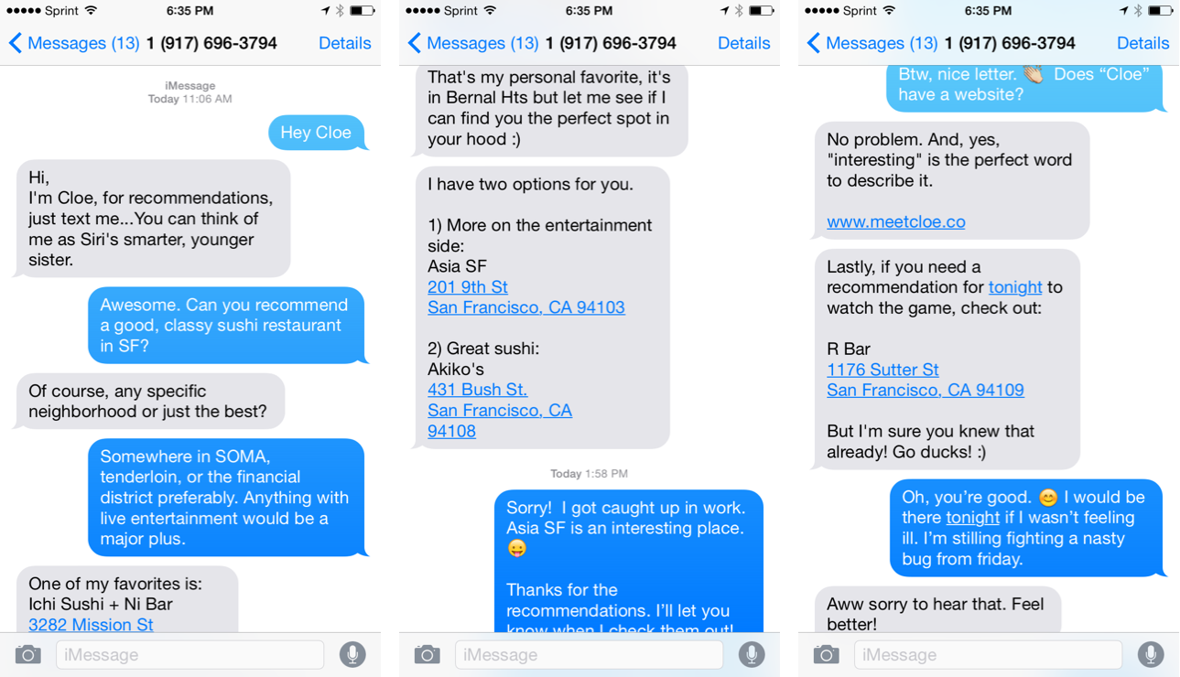
Sample Dialogue: Recommendations

Slide 5
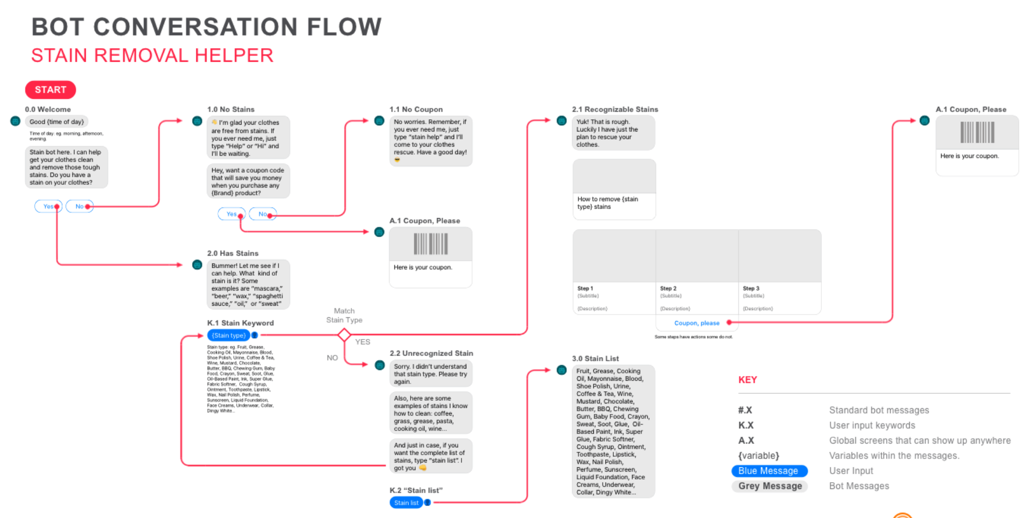
Sample Dialogue: Fabric Stain remover

Slide 6
Resource
Google Conversation Design:
https://developers.google.com/actions/design/
Write sample dialog
https://designguidelines.withgoogle.com/conversation/conversation-design-process/write-sample-dialogs.html#

